Slide 1
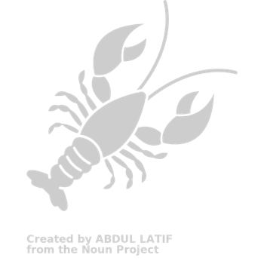
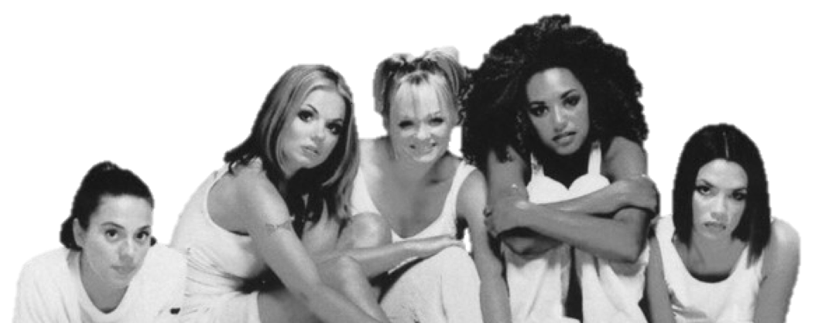
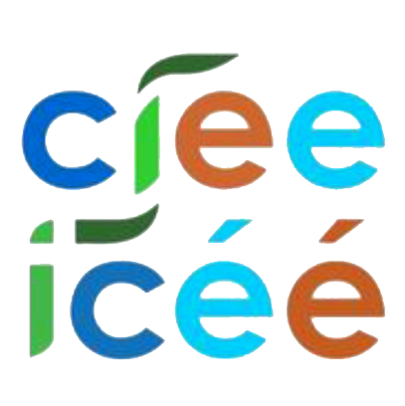
When 2 become 1 Linking subtidal and intertidal food webs in the nearshore community of Appledore
Joseph B. Burant, Tianna Peller, Julien Beaulieu, Nicole Knight, Jenny Muñoz, Laura Super, Ellen K. Bledsoe, Andrea Brown, Jennifer A. Dijkstra, Amelia Hesketh, Jake Lawlor, Alexis Pereira, Kate Sheridan, Kylla M. Benes, Jarrett E. K. Byrnes
canadian institute of ecology and evolution institut canadien d’écologie et d’évolution

Slide 2
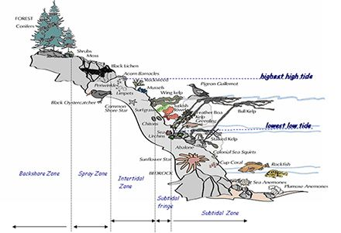
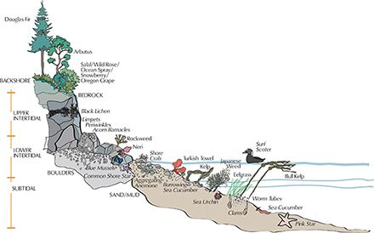
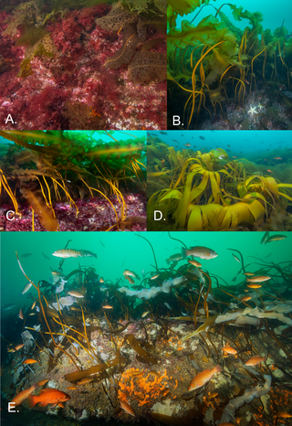
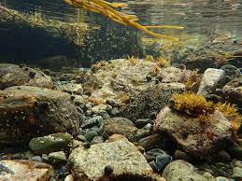
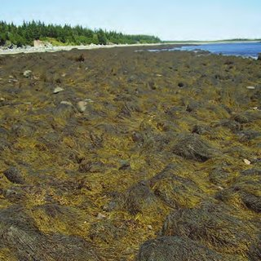
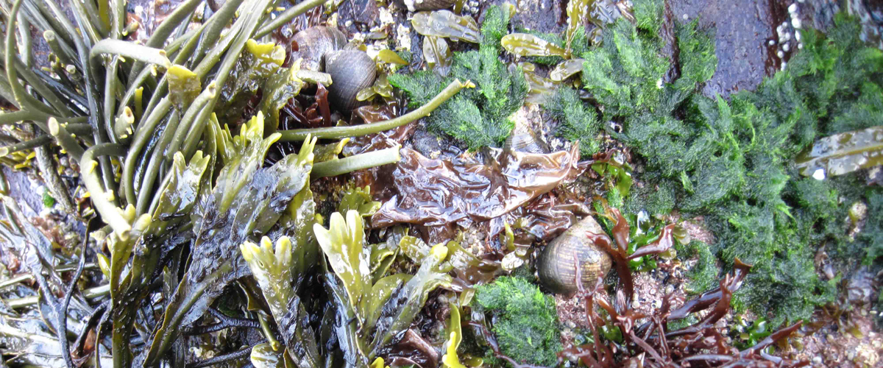
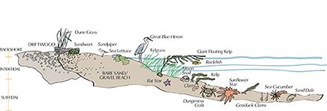
The nearshore ecosystem
Subtidal
Images: crd.bc.ca
Intertidal
Image: American Fisheries Society
Image: Alan T. Critchley
Image: Whitman & Lamb (2018)
Image: Northeastern University

Slide 3
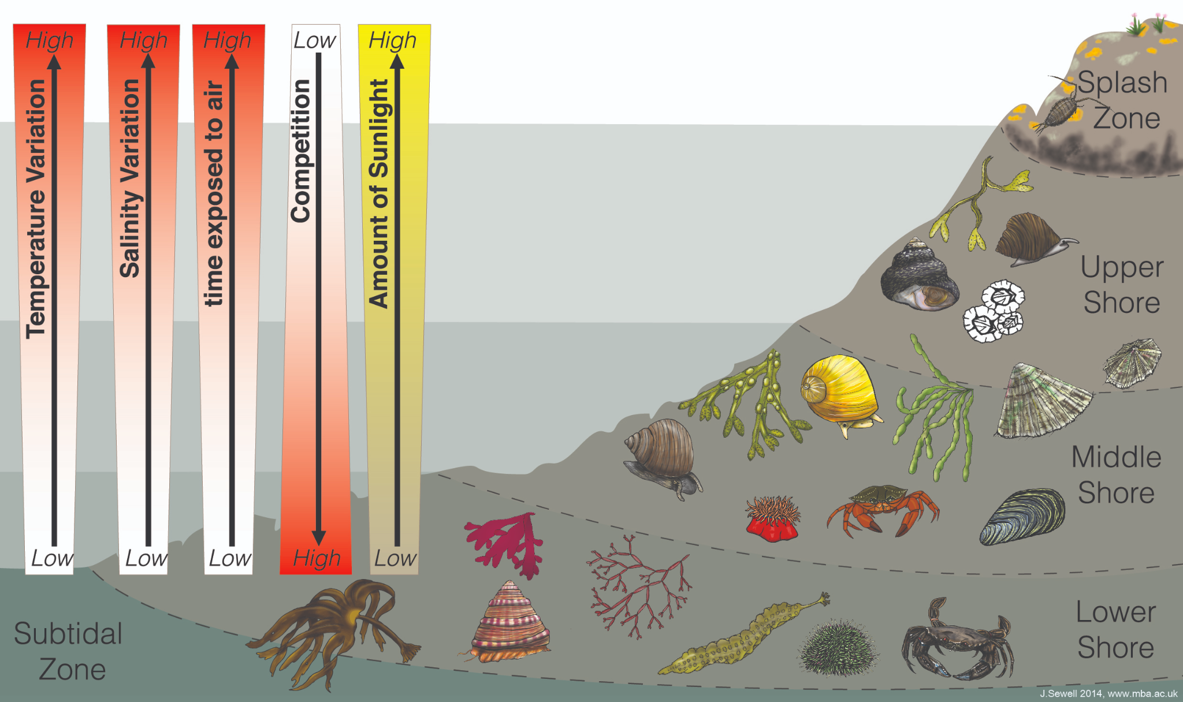
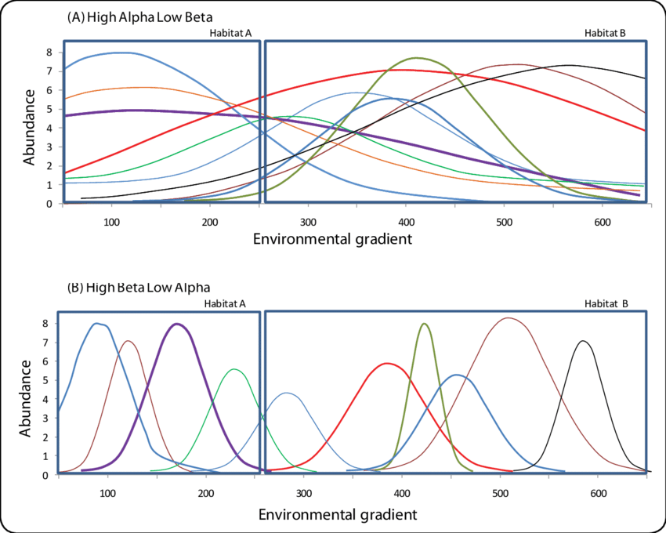
Separate study, but they’re clearly linked
Rationale
environment and biodiversity are continuous, rather than discrete
high overlap
mostly separate
Mechanisms
trophic interactions
species co-occurrence
life-history interactions (e.g. natal sites)
J. Sewell (2014), Marine Biological Association * does not depict the GoM nearshore
Von Maltitz et al. (2013), Assessing Sustainability * does not depict GoM nearshore species distributions

Slide 4
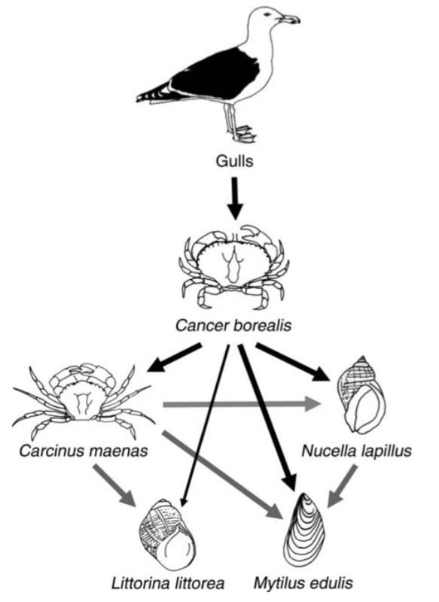
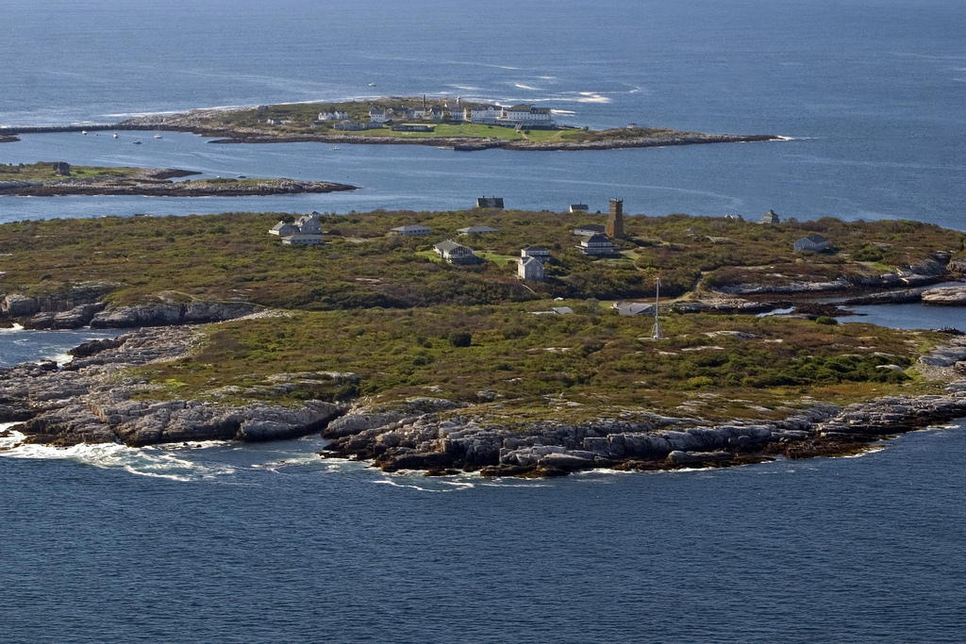
How do cross-habitat links alter food web structure?
Image: Jeremy D’Entremont (flickr)
terrestrial
subtidal
intertidal
Fig. 4 in Ellis et al. (2007), Ecology
Notes:
We identify all known connections in the intertidal, in the subtidal, and across the intertidal and subtidal. We characterize the links connecting the intertidal and subtidal (identify species, and specific motifs involved, (if we keep that angle), and we ask how these links alter our understanding of intertidal and subtidal food webs.
How does it affect the structure of a system as a whole AND/OR how does it affect individual nodes (e.g., their centrality)
What do we miss when we considered the subtidal and intertidal as separate communities?
Dummy networks w example connections between them
Steiborg
Trophic cascades? If you don’t link the zones you miss those interactions/motifs that could lead to a cascade in the system
Cross-ecosystem system transfer/flow of energy from intertidal to subtidal, and back again?
Cross-habitat species links and effects on network structure
Examples of how the subtidal and intertidal interact (REFs), but what does the whole picture look like? What’s the extent of those interactions
Ellis et al. (gulls to crabs); Stenick (crabs to urchins, lobsters, kelp)
Lafferty and Morton (including parasites in networks)

Slide 5
How do cross-habitat links alter food web structure?
Do the subtidal and intertidal exist as separate food webs?
To what extent are the two integrated?
Which species are linking these communities? Who are the key players in the integrated web?
To what extent does food web modularity reflect habitat divisions?
Image: Jeremy D’Entremont (flickr)
subtidal
intertidal
Notes:
We identify all known connections in the intertidal, in the subtidal, and across the intertidal and subtidal. We characterize the links connecting the intertidal and subtidal (identify species, and specific motifs involved, (if we keep that angle), and we ask how these links alter our understanding of intertidal and subtidal food webs.
How does it affect the structure of a system as a whole AND/OR how does it affect individual nodes (e.g., their centrality)
What do we miss when we considered the subtidal and intertidal as separate communities?
Dummy networks w example connections between them
Steiborg
Trophic cascades? If you don’t link the zones you miss those interactions/motifs that could lead to a cascade in the system
Cross-ecosystem system transfer/flow of energy from intertidal to subtidal, and back again?
Cross-habitat species links and effects on network structure
Examples of how the subtidal and intertidal interact (REFs), but what does the whole picture look like? What’s the extent of those interactions
Ellis et al. (gulls to crabs); Stenick (crabs to urchins, lobsters, kelp)
Lafferty and Morton (including parasites in networks)

Slide 6
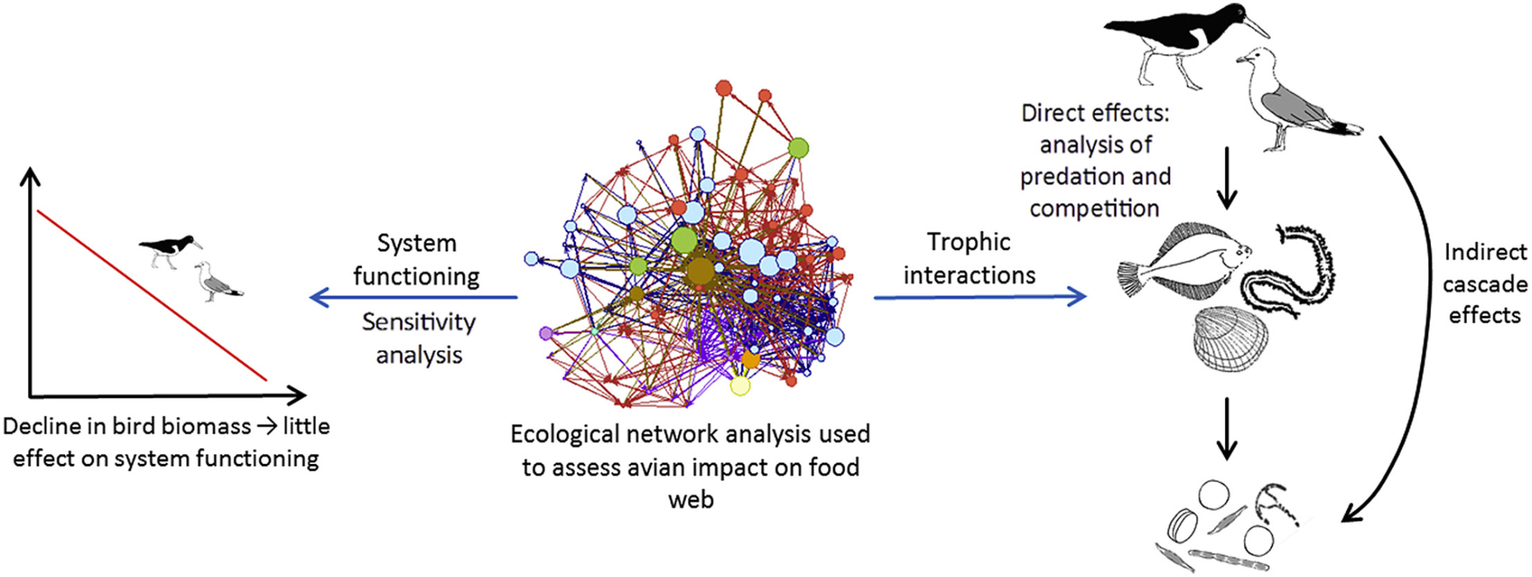
Network analysis can identify key links
What is (ecological) network analysis?
an holistic approach to characterize features and components of a “system” that may not be obvious from direct observation
Graphical Abstract in Horn et al. (2019), Estuar. Coast. Shelf Sci.
Fath et al. (2007), Ecological Modelling

Slide 7
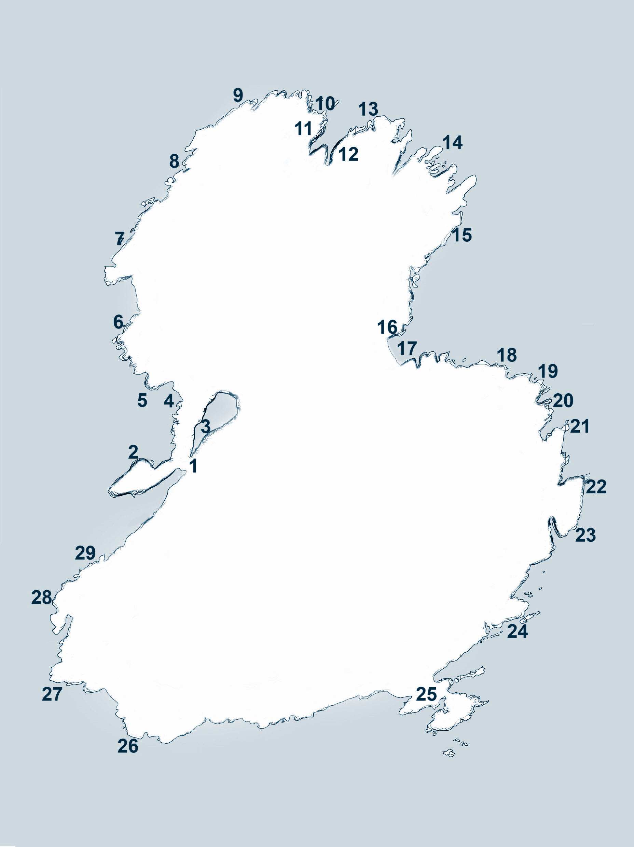

Sampling at Appledore Island, Isles of Shoals
Image: Jarrett Byrnes
Intertidal surveys
1983 – Present
29 transects, irregular sampling
Subtidal surveys
2013 – Present
12 regularly-sampled transects
Appledore Island
Sampled 5 years of overlapping data from 2014-2018

Slide 8
Sampling at Appledore Island, Isles of Shoals
Image: Jarrett Byrnes
Subtidal transect
Intertidal transect
Appledore Island

Slide 9
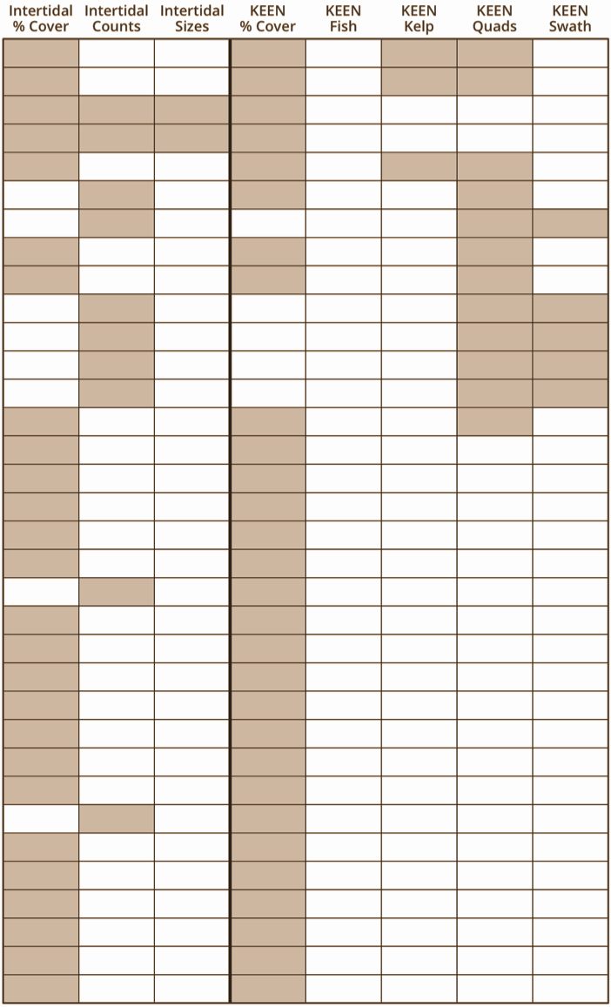
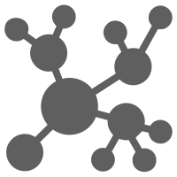
Island list(s) → interaction-based network
Intertidal
Subtidal
Island-wide species list combining all sites and years in our sample → 144 unique “species”
caveat: unaccounted relative abundance
Species assigned as strictly subtidal, strictly intertidal, or found in both zones
many datasets
Systematic literature for trophic interactions involving focal species and others in Gulf of Maine
Global Biotic Interactions (Globi)
few datasets

Slide 10
Quantifying network structure and modularity
Network metrics
total number of “species”(nodes)
total number interactions (links)
link density (nodes / links)
Modularity analysis
modularity = strength of division within a network; fraction of links that fall within a module minus expected random fraction
Node (species) level metrics
centrality = a measure of node “importance” within the network – many approaches!
degree = number of links connecting to a node (integer)
eigen centrality = weighted measure of the links to a node, and links to its links, etc.
leading eigenvector modularity
Notes:
Hypothesis: modularity does not align with habitat divisions
Eigen Centrality:
Definition: Like degree centrality, EigenCentrality measures a node’s influence based on the number of links it has to other nodes in the network. EigenCentrality then goes a step further by also taking into account how well connected a node is, and how many links their connections have, and so on through the network.
What it tells us: By calculating the extended connections of a node, EigenCentrality can identify nodes with influence over the whole network, not just those directly connected to it.
When to use it: EigenCentrality is a good ‘all-round’ SNA score, handy for understanding human social networks, but also for understanding networks like malware propagation.
A bit more detail: Our tools calculate each node’s EigenCentrality by converging on an eigenvector using the power iteration method. Learn more about EigenCentrality

Slide 11


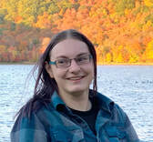
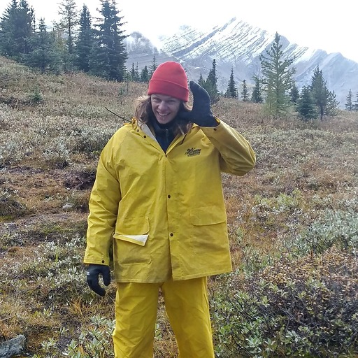
Nicole Knight
Bird’s-eye view
Kate Sheridan
Julien Beaulieu
Notes:
Because I’m an ornithologist, I have to get the word bird into this talk somehow… So, we’re going to take a bird’s eye view of the nearshore food web. There are many more specific details of these networks that I simply don’t have time for in a 15-minute talk, so I want to show you more generally what we mean by an integrated network. Jarret’s already described some of the key interactions in this system. Stick around to hear talks from my colleagues that will look in more detail at how species interactions related to changes in composition and function through time.

Slide 12
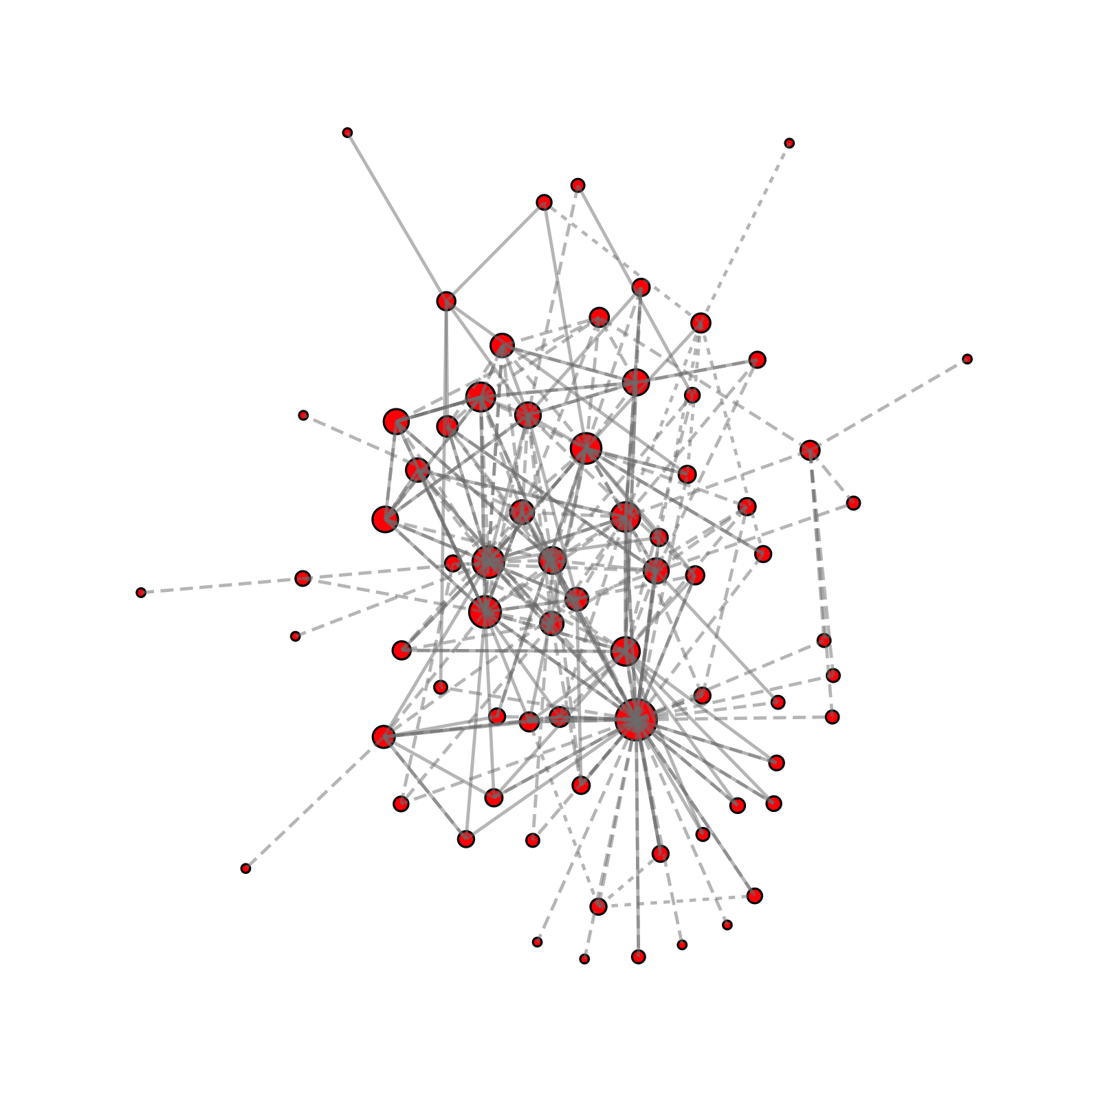
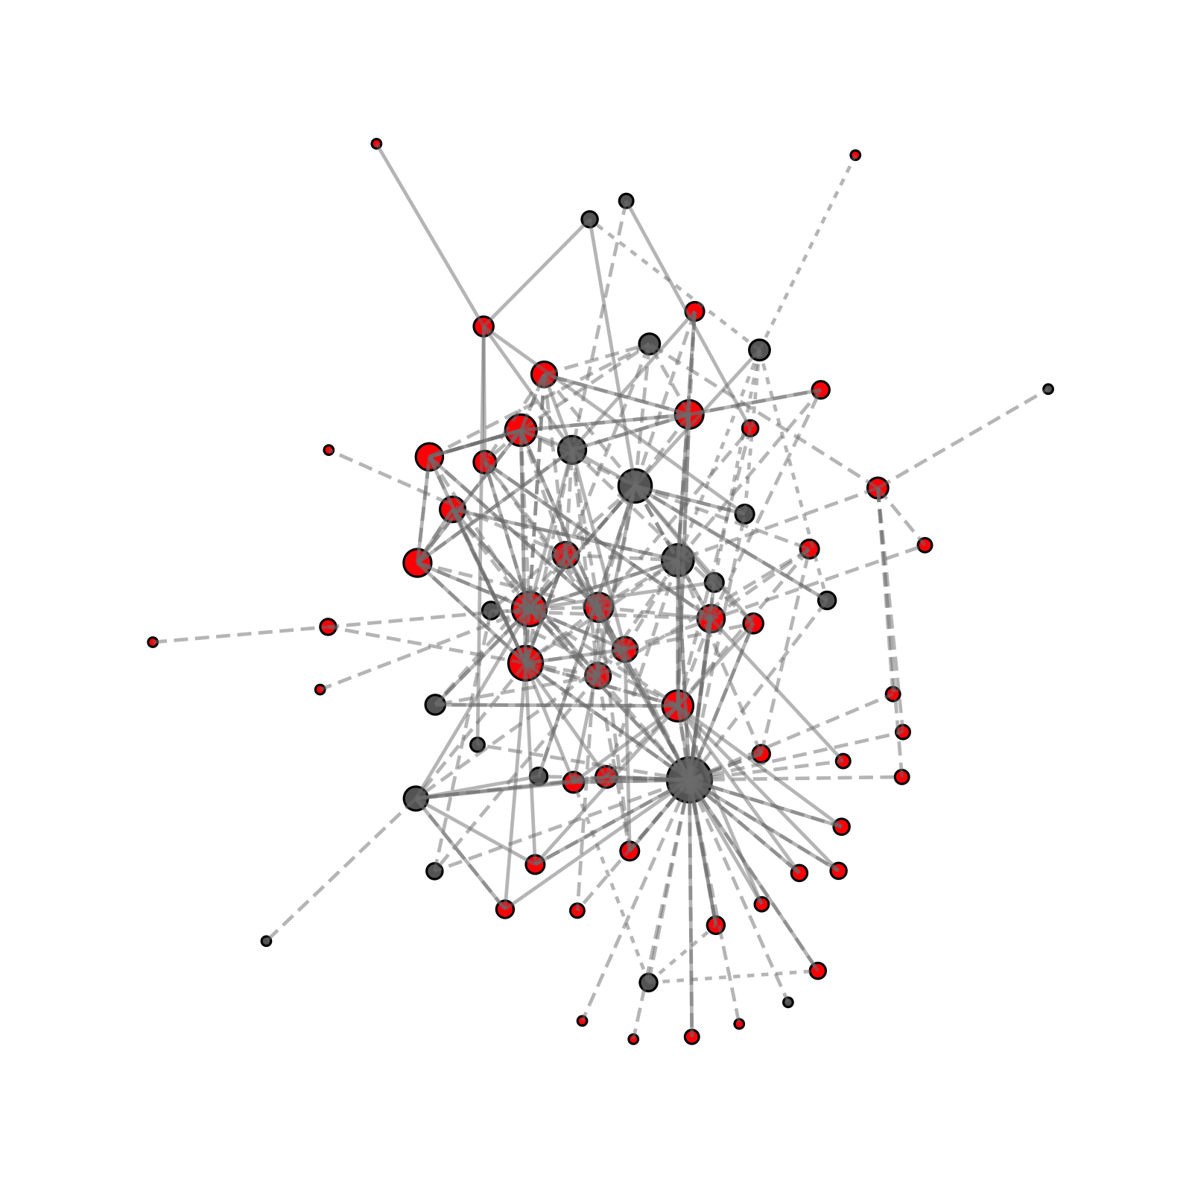
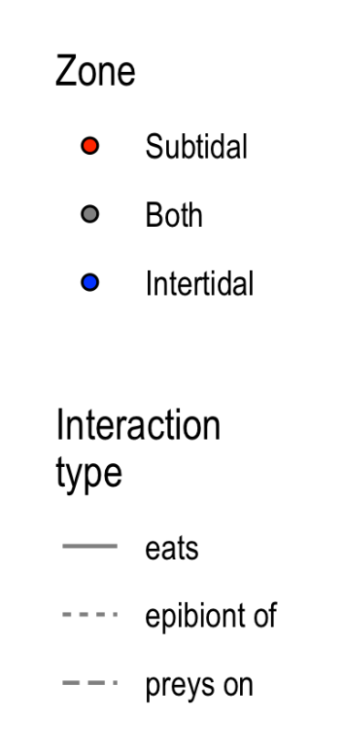
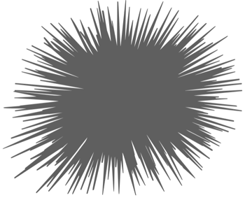
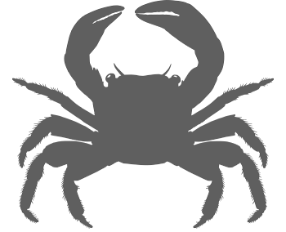
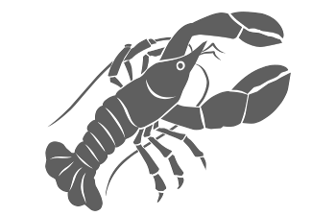

Appledore’s subtidal community
# of nodes = 71
# of links = 291
link density = 8.20 ± 9.99
Most connected species (degree)
Green sea urchin (61)
Atlantic rock crab (31)
American lobster (31)
7 species with degree ≥ 20
* nodes are weighted by link density
Notes:
Green sea urchin = Strongylocentrotus droebachiensis
Atlantic rock crab = Cancer irroratus
American lobster = Homarus americanus

Slide 13
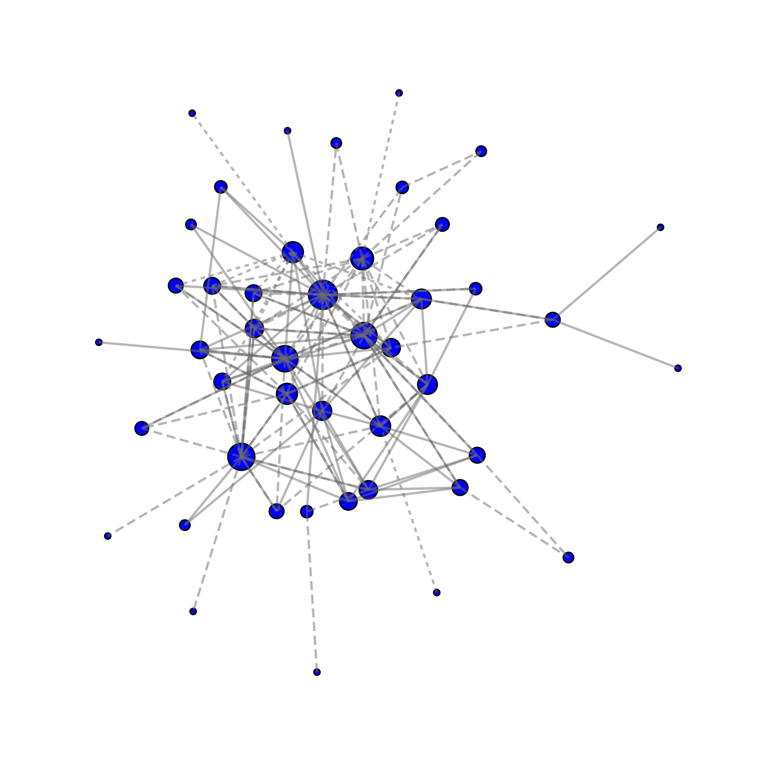
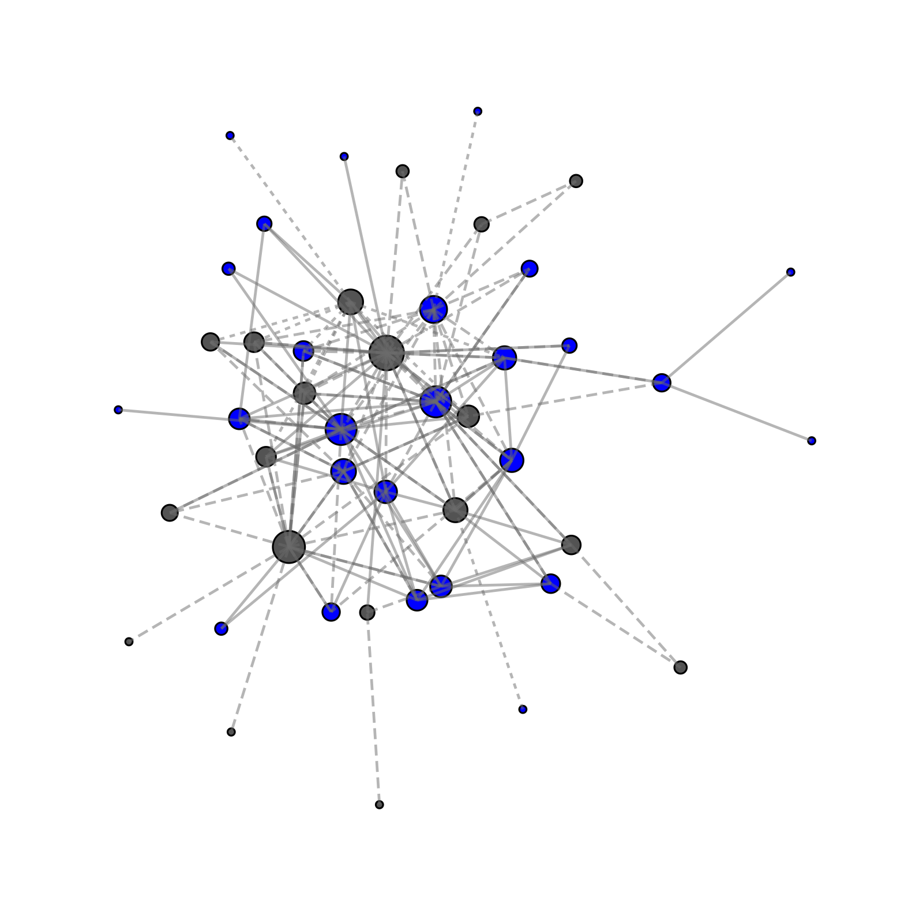
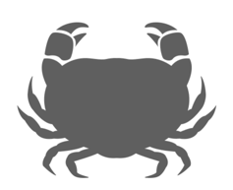
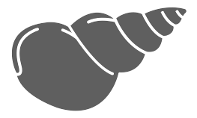
Appledore’s intertidal community
# of nodes = 45
# of links = 159
link density = 7.07 ± 7.04
Most connected species (degree)
European green crab (30)
Green sea urchin (25)
Common periwinkle (23)
4 species with degree ≥ 20

Slide 14
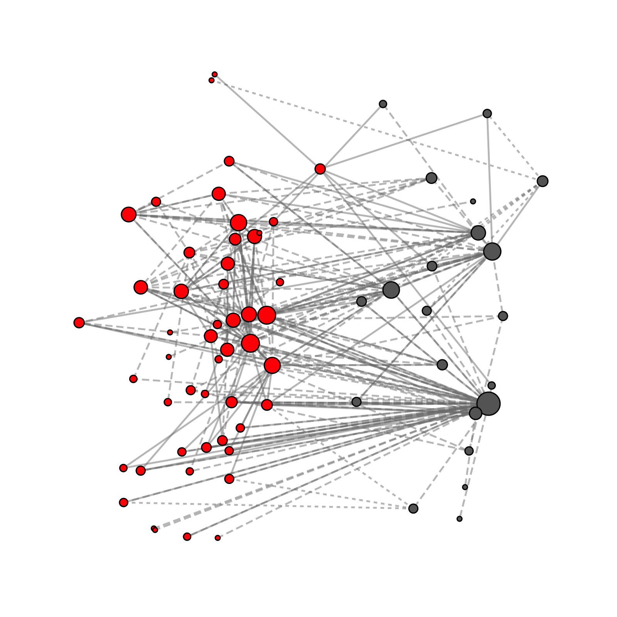
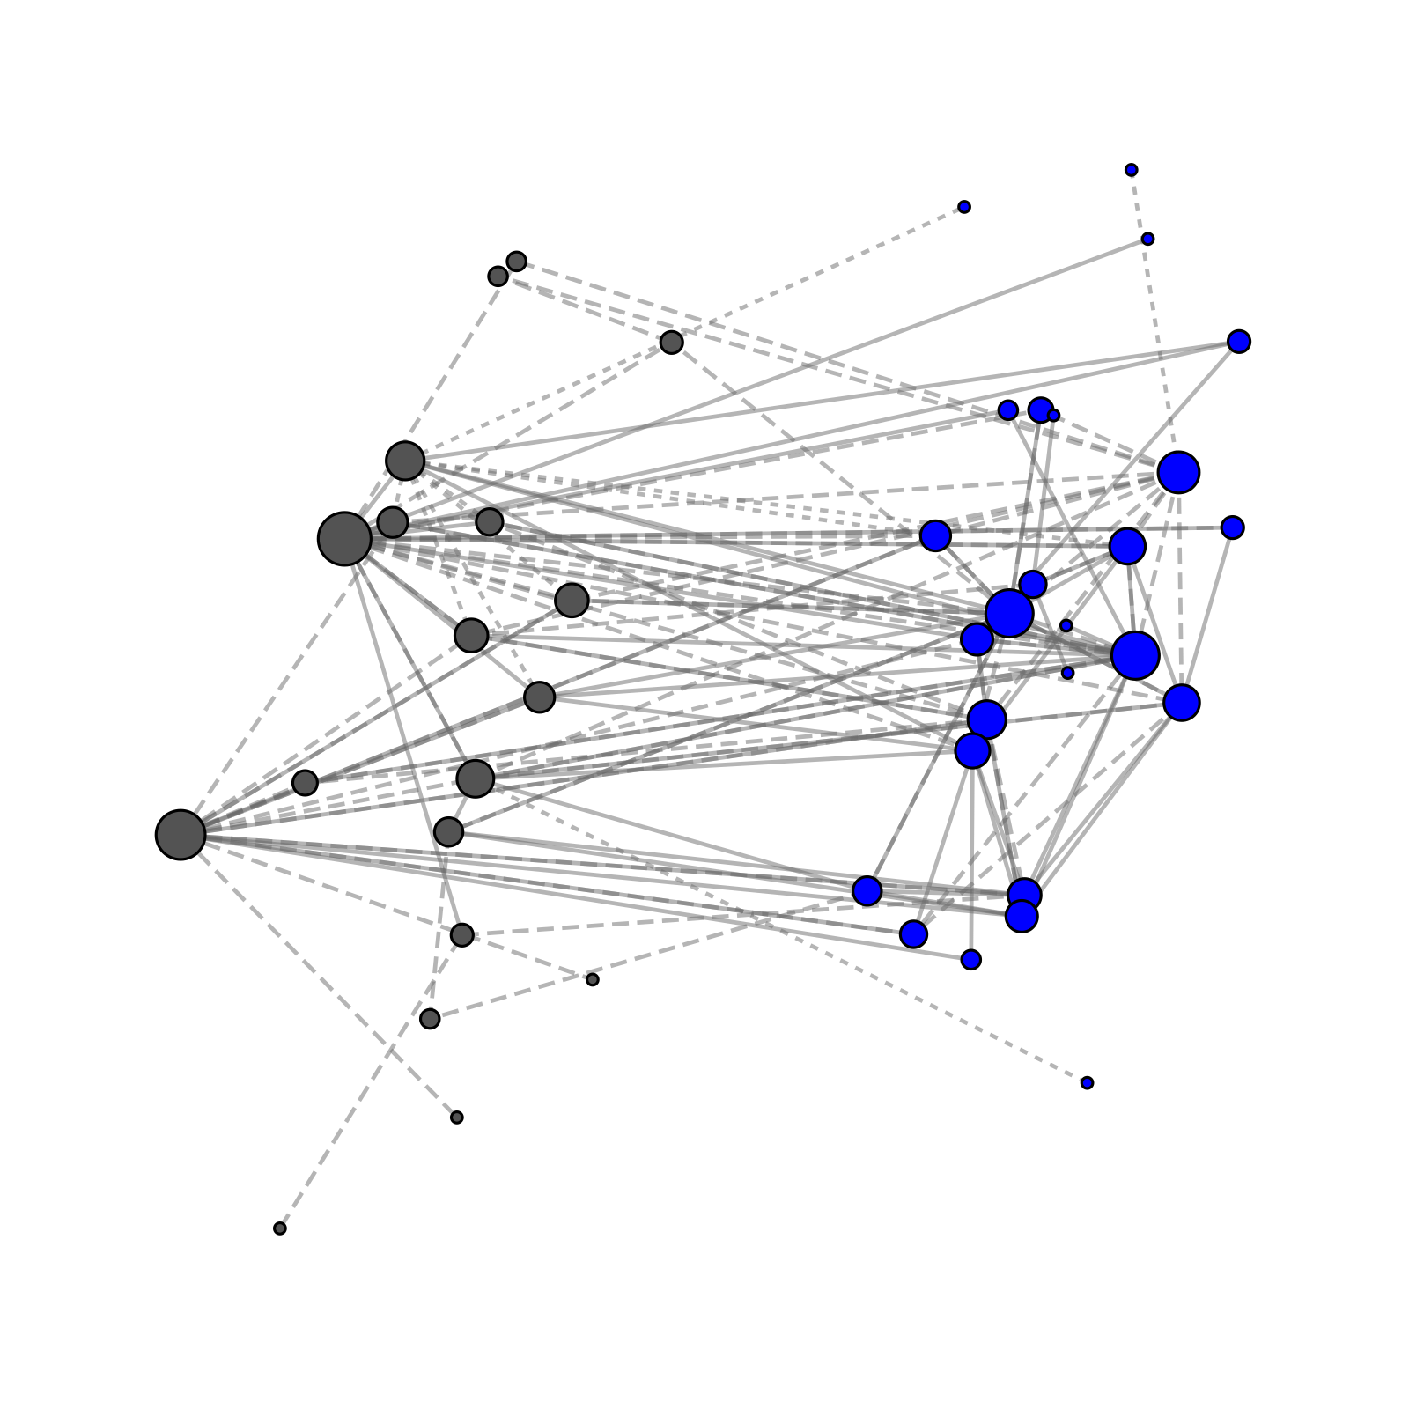
Two distinct networks? not so much…
Subtidal
Intertidal
Carcinus maenas
Mytilus edulis
Strongylocentrotus droebachiensis
Ascophyllum nodosum
1 – Green sea urchin (B) 2 – Atlantic rock crab (S) 3 – American lobster (S)
1 – European green crab (B) 2 – Common periwinkle (I) 3 – Dogwhelk (I)
Notes:
Species indicate three most central species (based on eigenvector centrality)
European green crab = Carcinus maenas
Common periwinkle = Littorina littorea
Dogwhelk = Nucella lapillus

Slide 15
Two distinct networks? not so much…
Subtidal
Intertidal
Carcinus maenas
Mytilus edulis
Strongylocentrotus droebachiensis
Ascophyllum nodosum
Notes:
Species indicate three most central species (based on eigenvector centrality)
European green crab = Carcinus maenas
Common periwinkle = Littorina littorea
Dogwhelk = Nucella lapillus

Slide 16
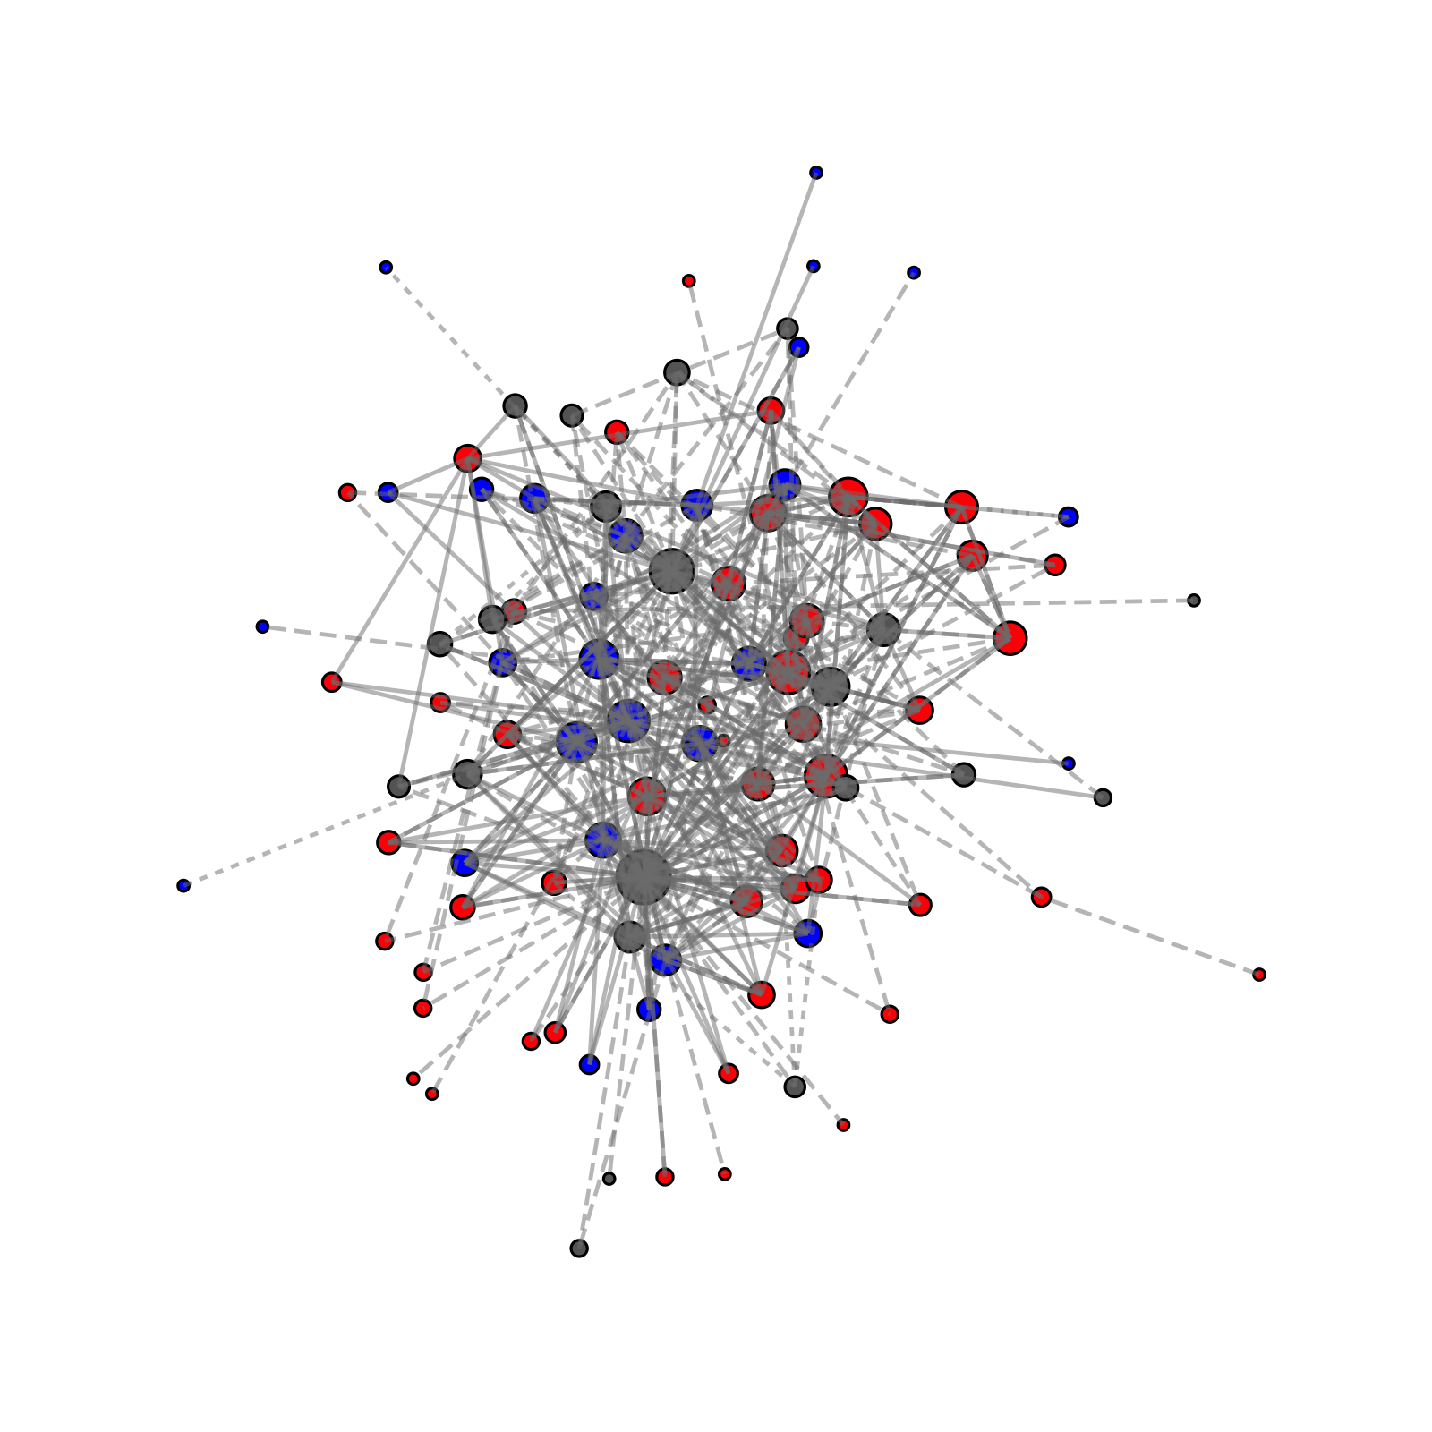
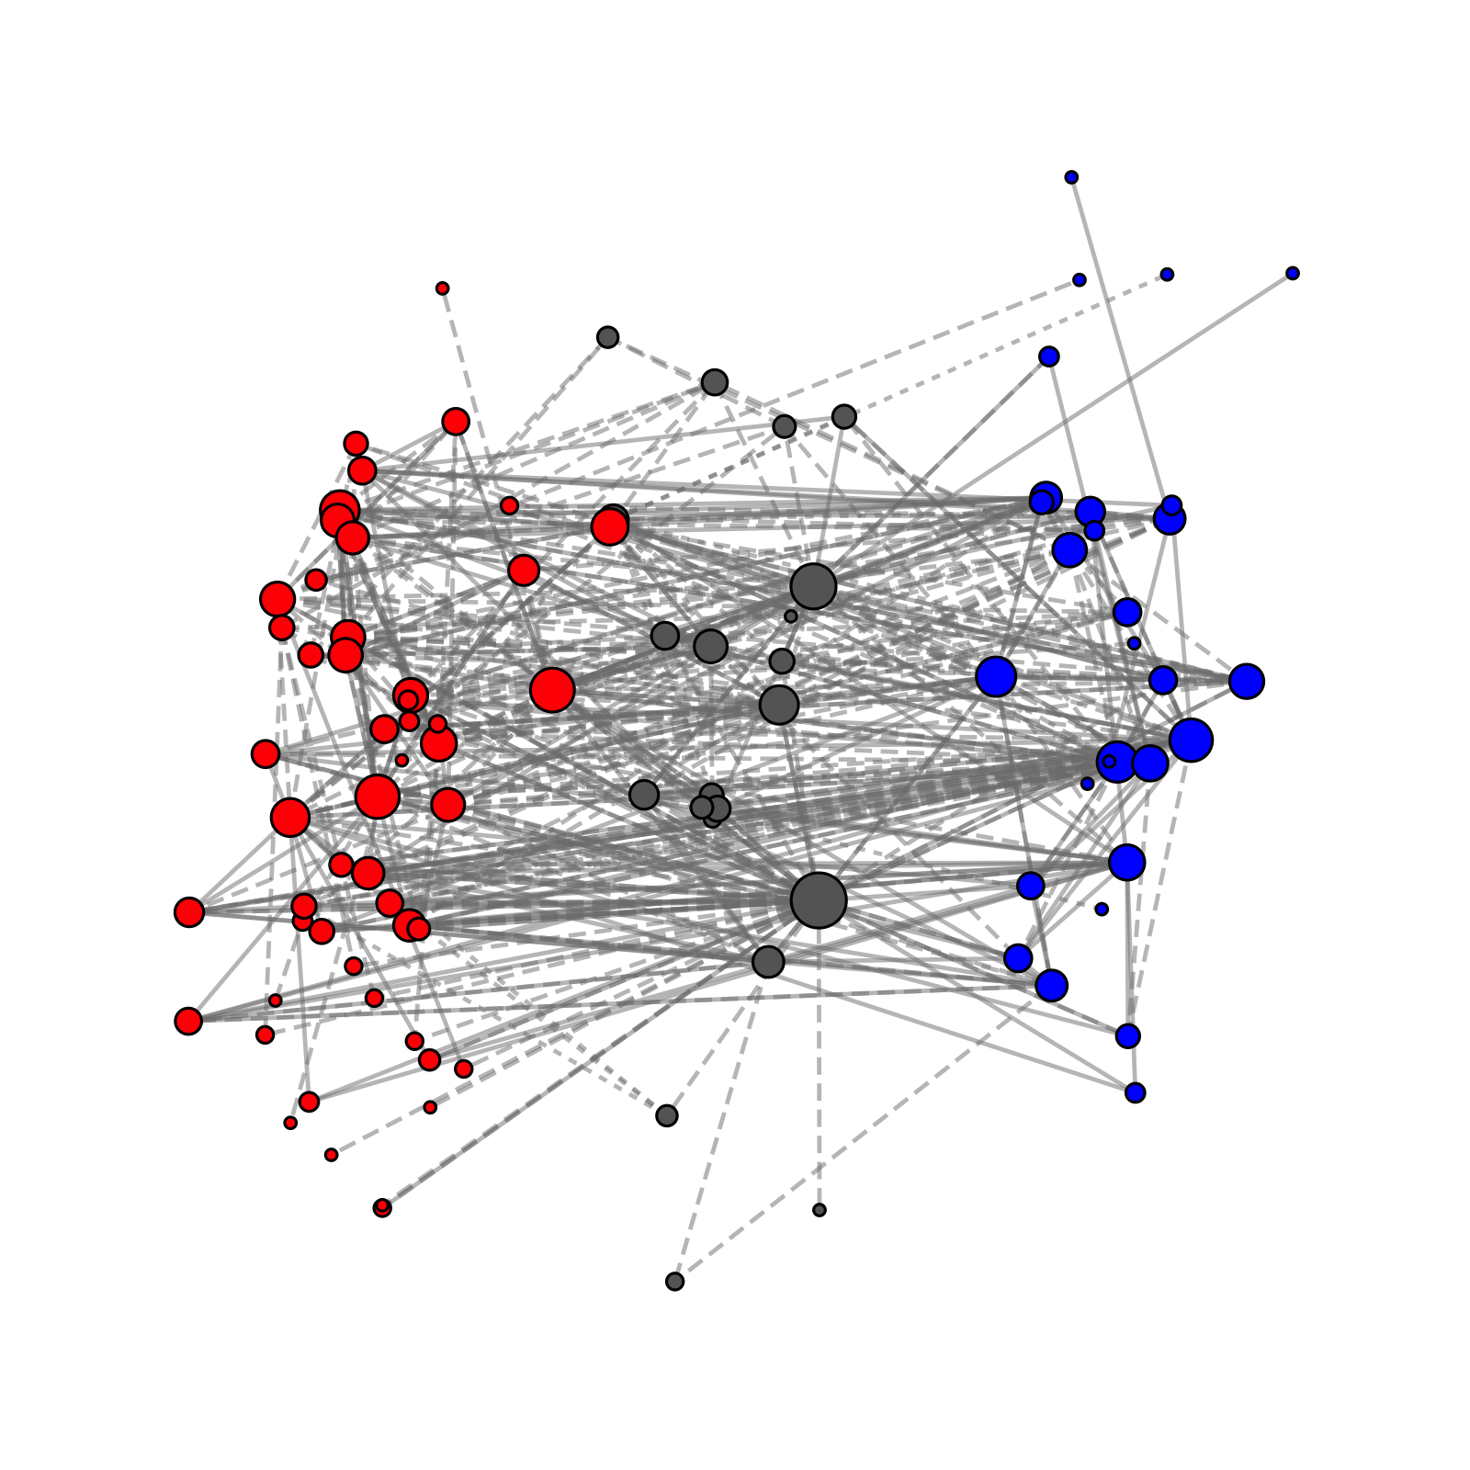
The integrated nearshore food web
# of nodes = 101
# of links = 548
link density = 10.9 ± 11.7
Most connected species (degree)
Green sea urchin (72)
European green crab (43)
American lobster (40)
17 species with degree ≥ 20

Slide 17
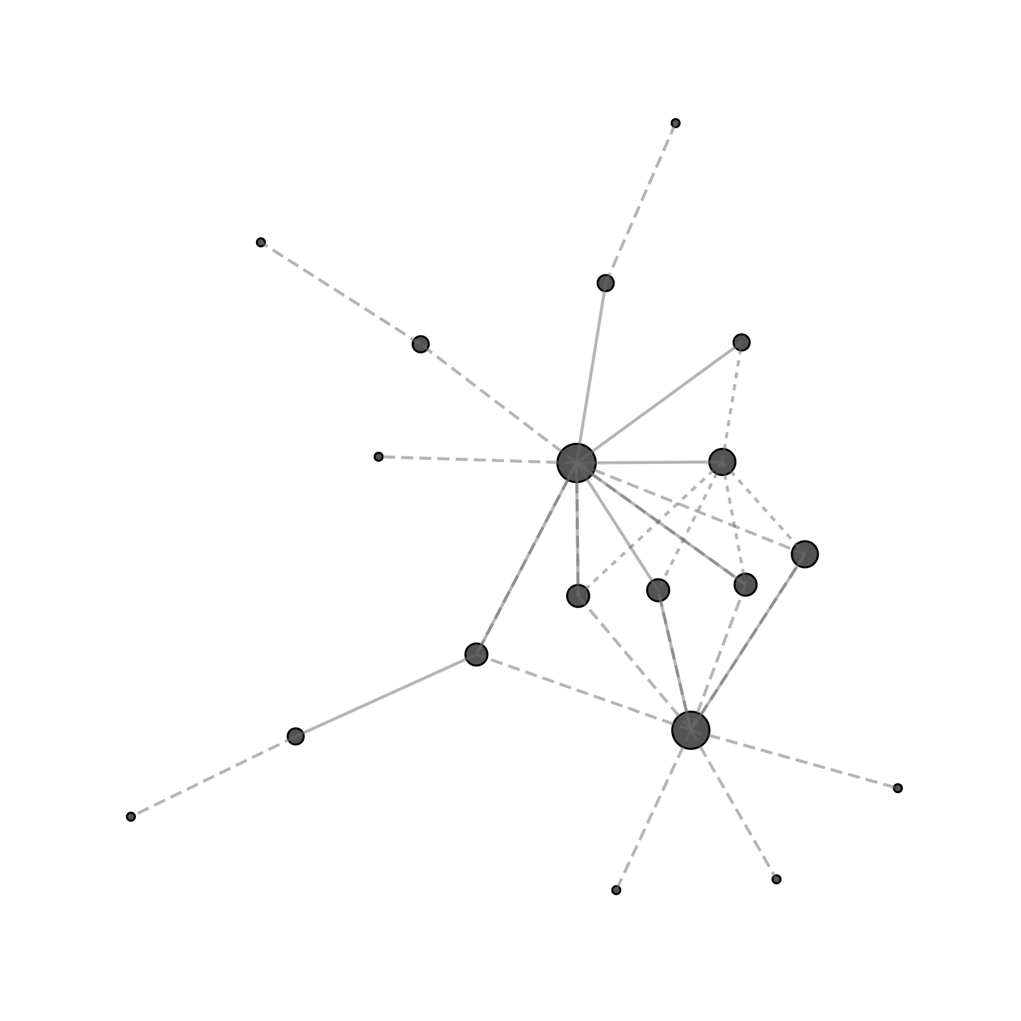
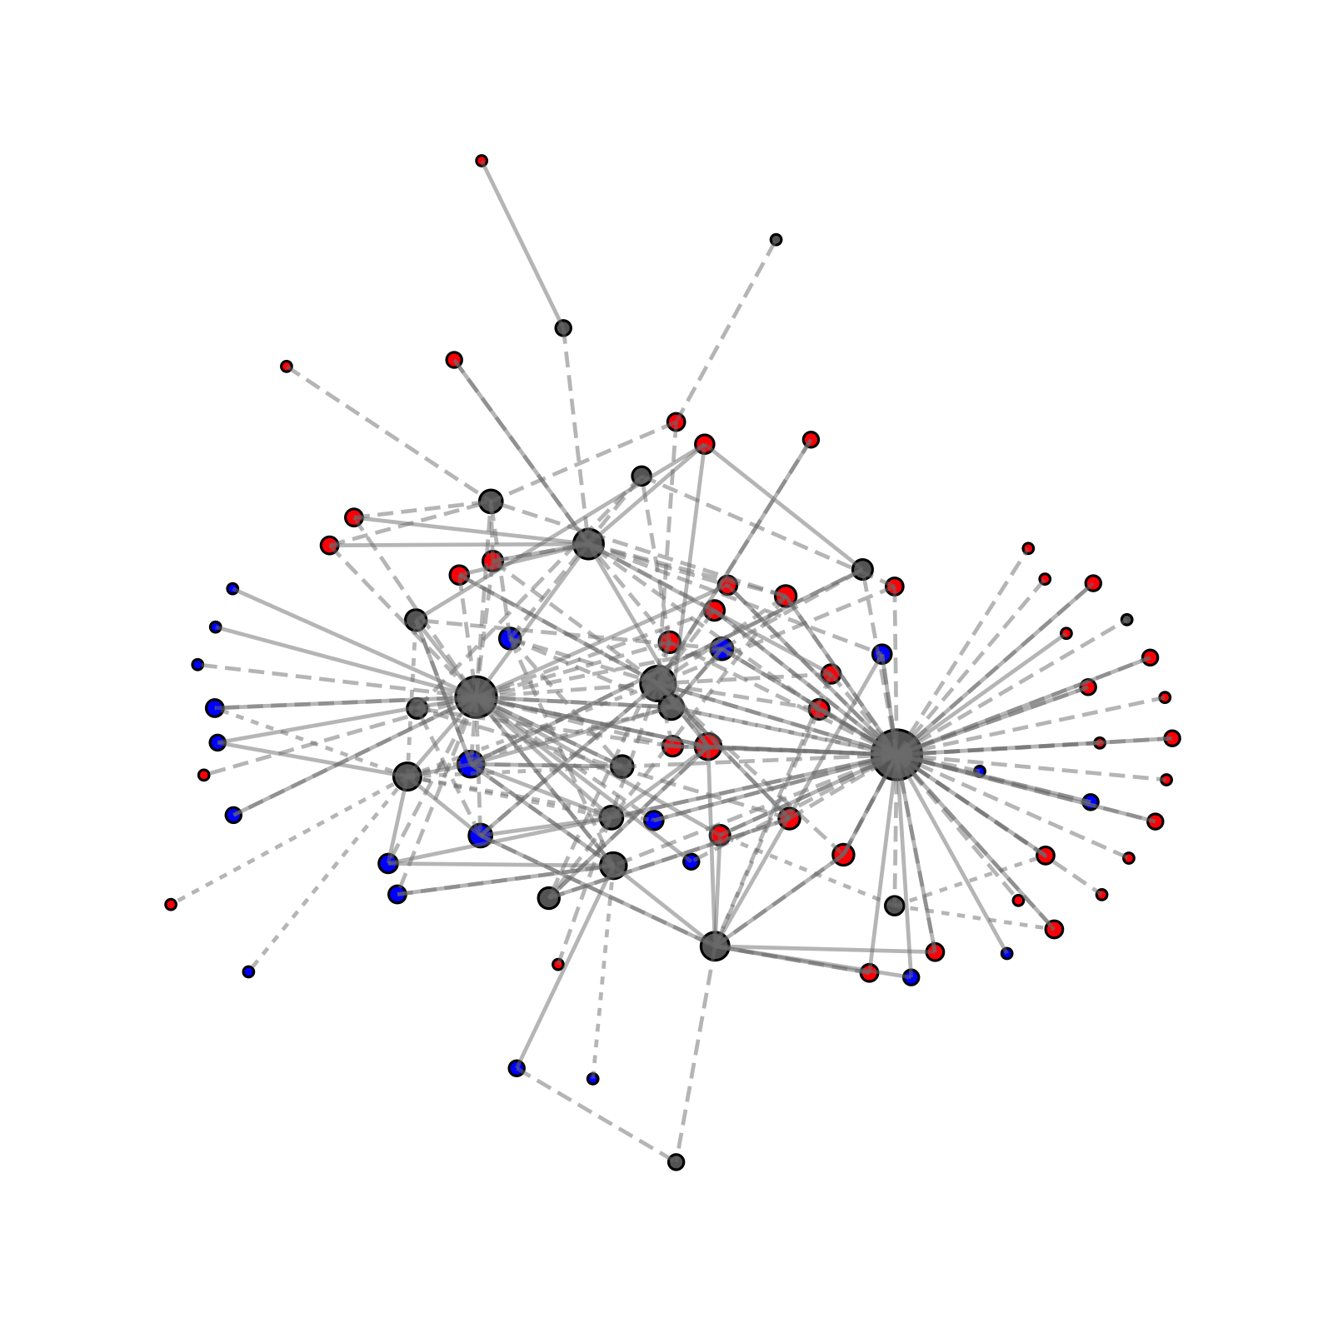
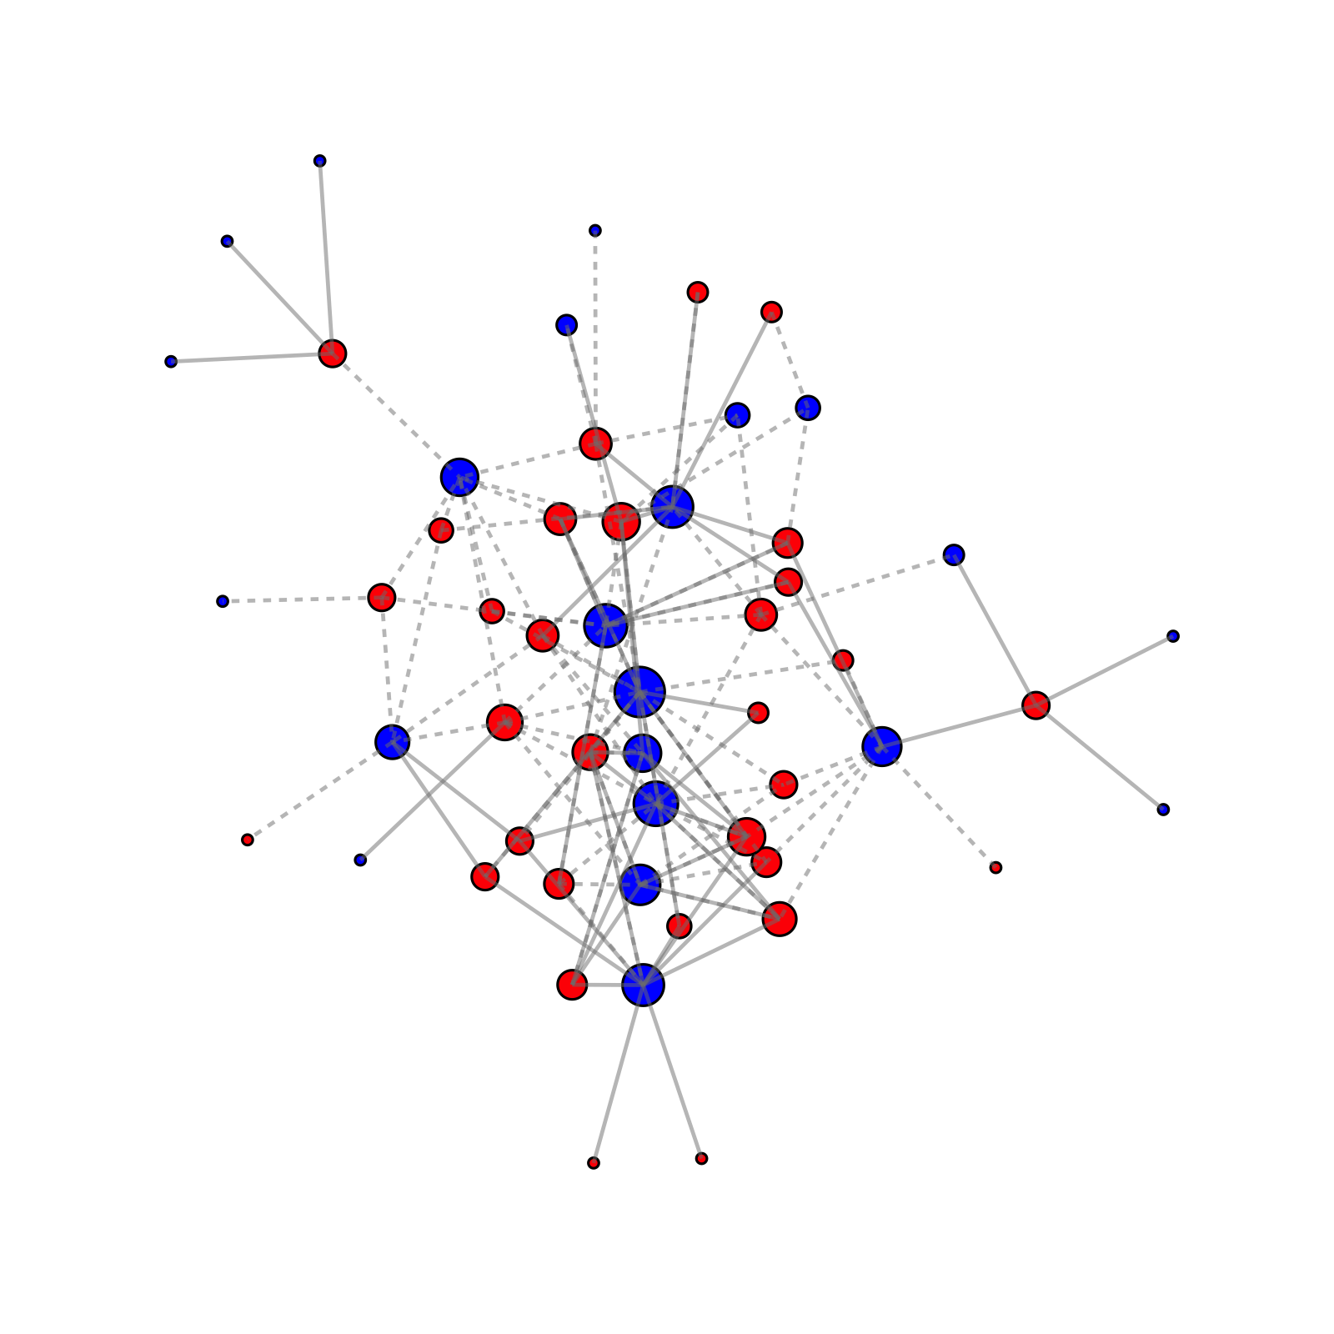
Parts of the integrated network
Both (only)
Both + 1º links
Subtidal <--> Intertidal
19 of 21 species found in both zones, with 36 direct interactions between them
235 interactions between 86 species (22 strictly intertidal and 43 strictly subtidal)
134 interactions span the subtidal (31 species) and intertidal (22 species)
Notes:
Both (only) is also an underestimate because many species in the subtidal island list likely also occur in the intertidal, but only at high tides (outside of sampling) – this could probably be fixed, but it’s also sort of the point!
2 species missing from Both (only), because they are not connected to other species who occur in both zones: Botrylloides violaceus (chain tunicate) and Modiolus modiolus (northern horse mussel)
They are included in the Both + 1º network

Slide 18
Who’s linking the integrated food web?
Both (only)
Both + 1º links
Subtidal <--> Intertidal
1 – European green crab 2 – Green sea urchin 3 – Blue mussel
1 – Green sea urchin 2 – European green crab 3 – Blue mussel
1 – Northern lacuna (I) 2 – Dogwhelk (I) 3 – Sugar kelp (S)
Notes:
Species indicate three most central species (based on eigenvector centrality)
Blue mussel = Mytilus edulis
Sugar kelp = Saccharina latissima

Slide 19
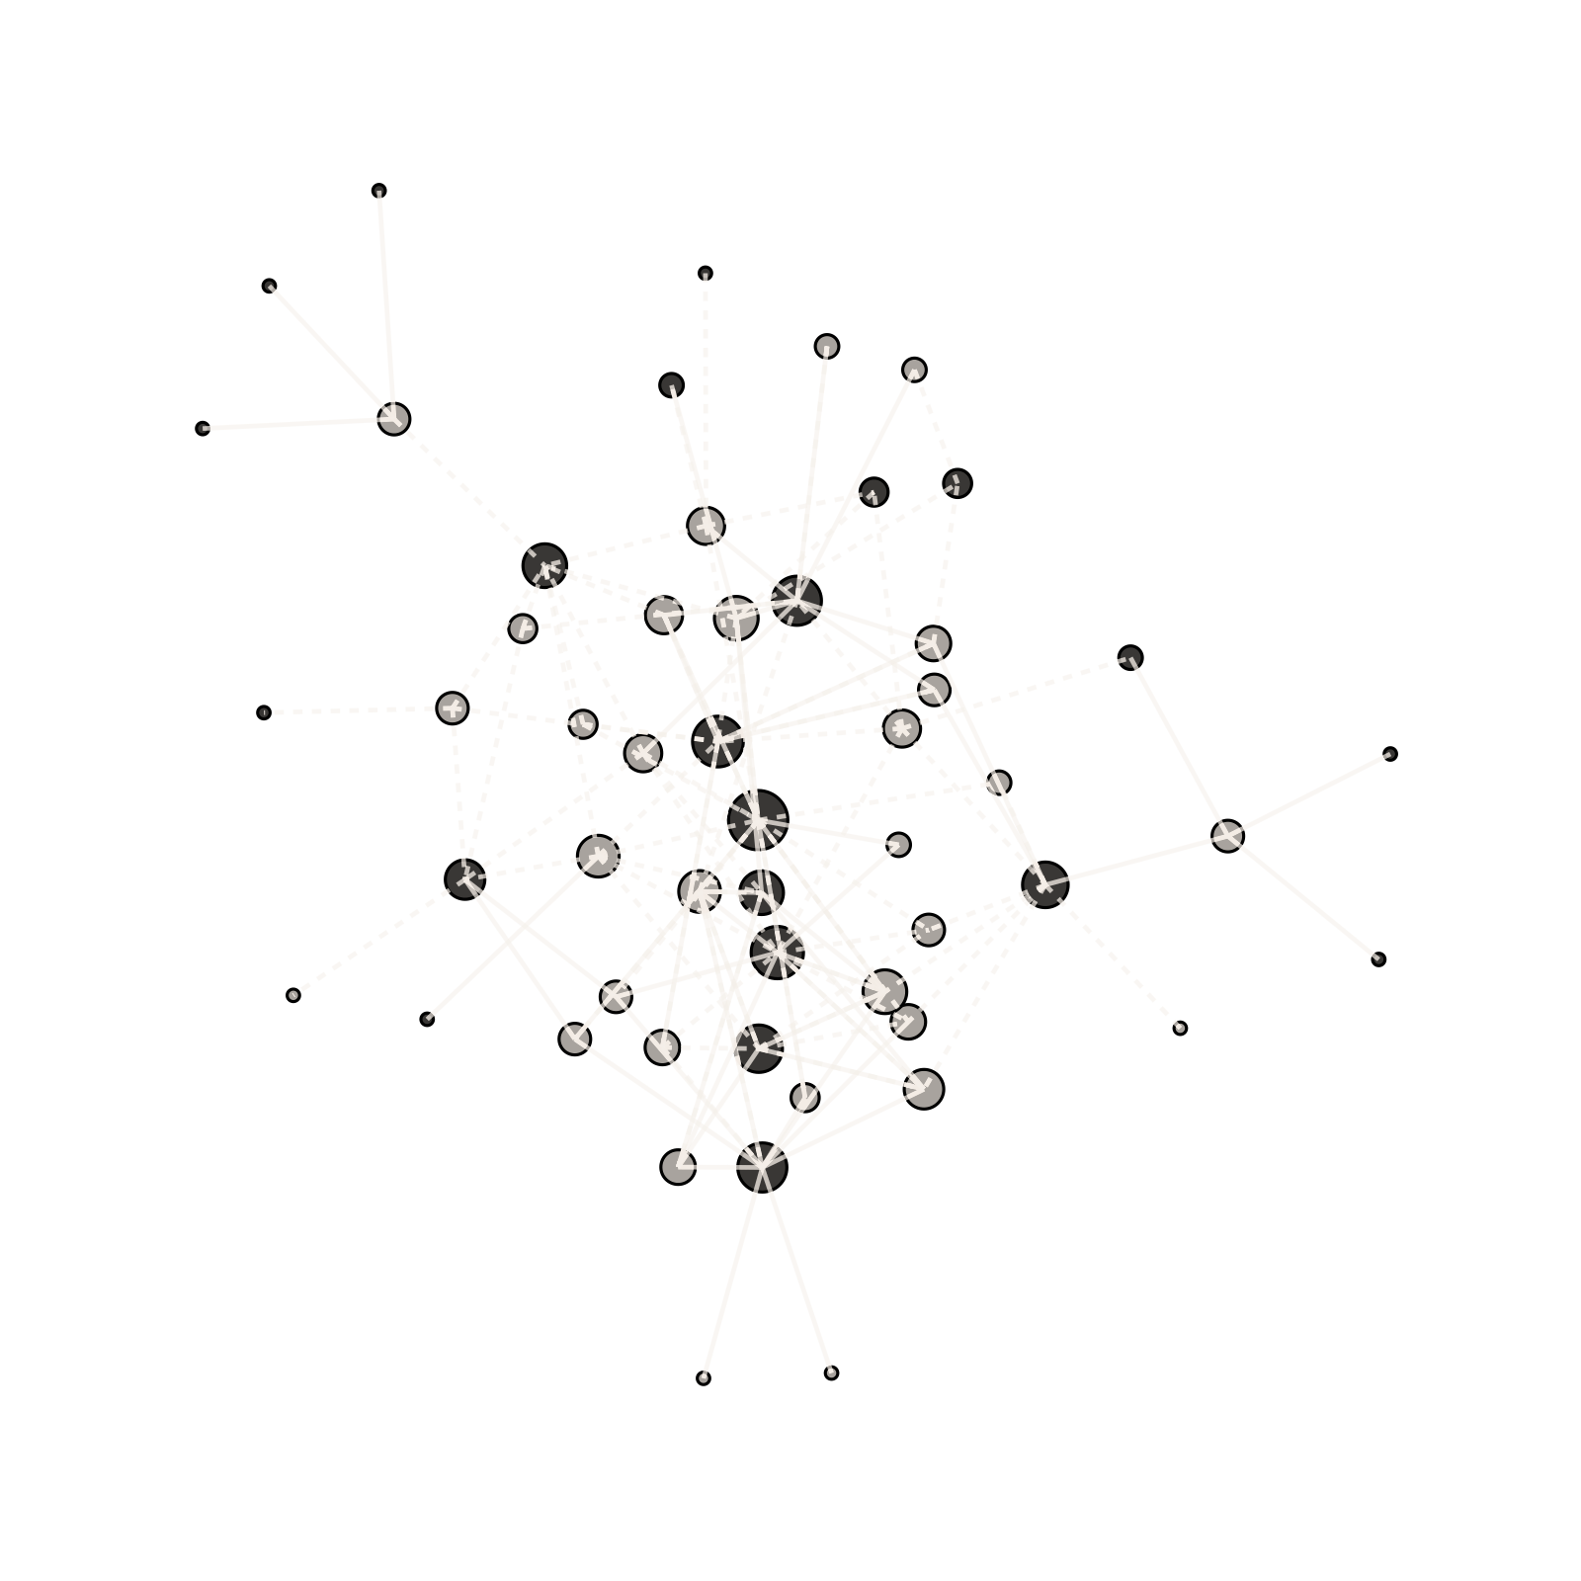

The “missing” network
24%
of interactions directly span subtidal and intertidal habitats

Slide 20
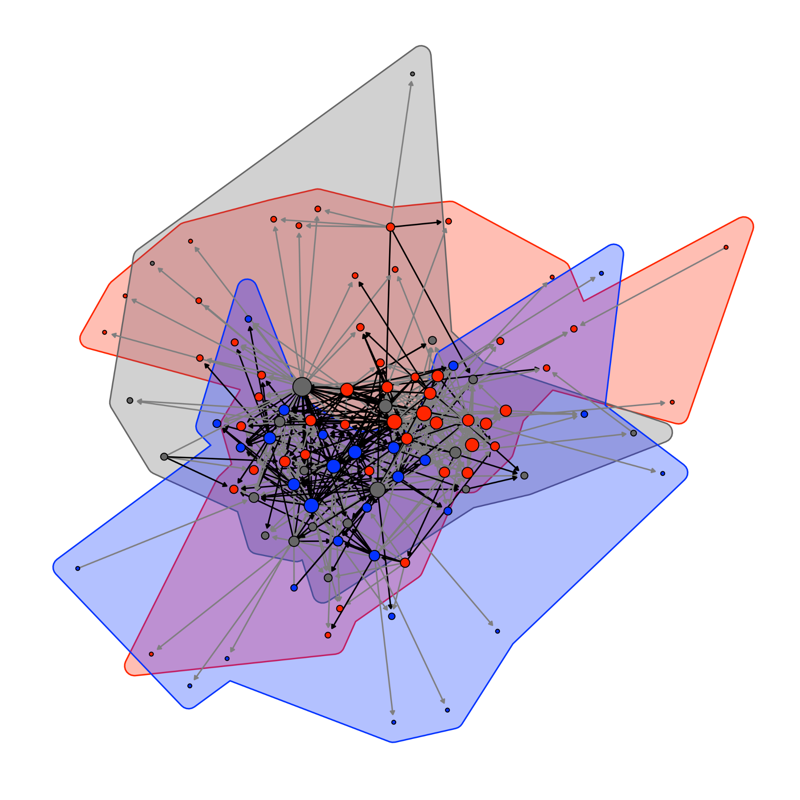
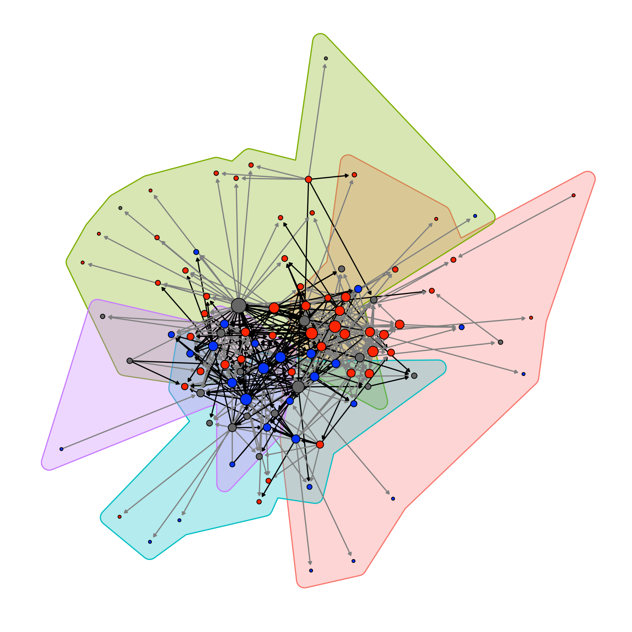
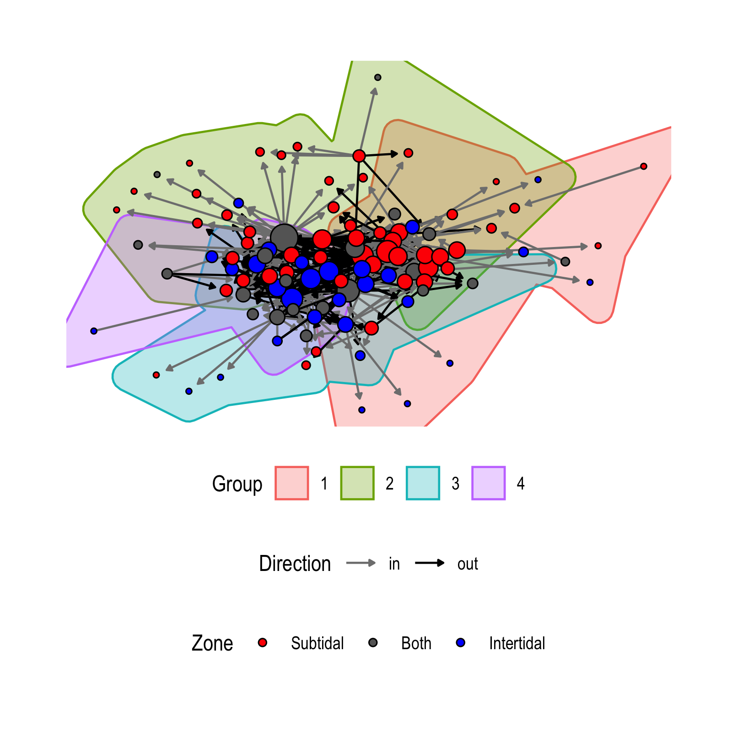
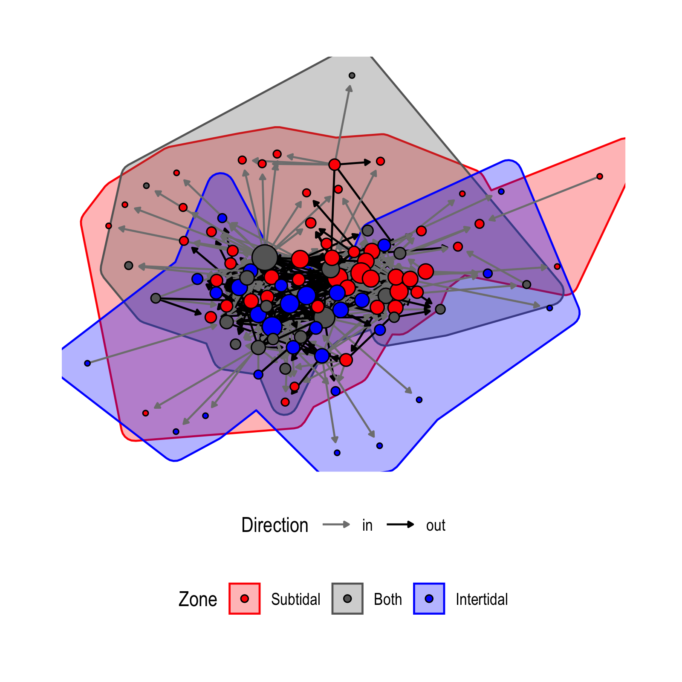
Modularity analysis
imposed habitat separation
optimal network partitioning
modularity = 0.03 (very weak)
modularity = 0.30 (moderate)
Notes:
Compared to 1000 random networks with the same number of nodes and edges, our network is significantly more modular (p<0.001, mean modularity for random network = 0.22).
However, linear discriminant analysis could not significantly distinguish modules by habitat (p=0.5, Fig. 3), which suggests that habitats do not form natural boundaries for food-web modules

Slide 21
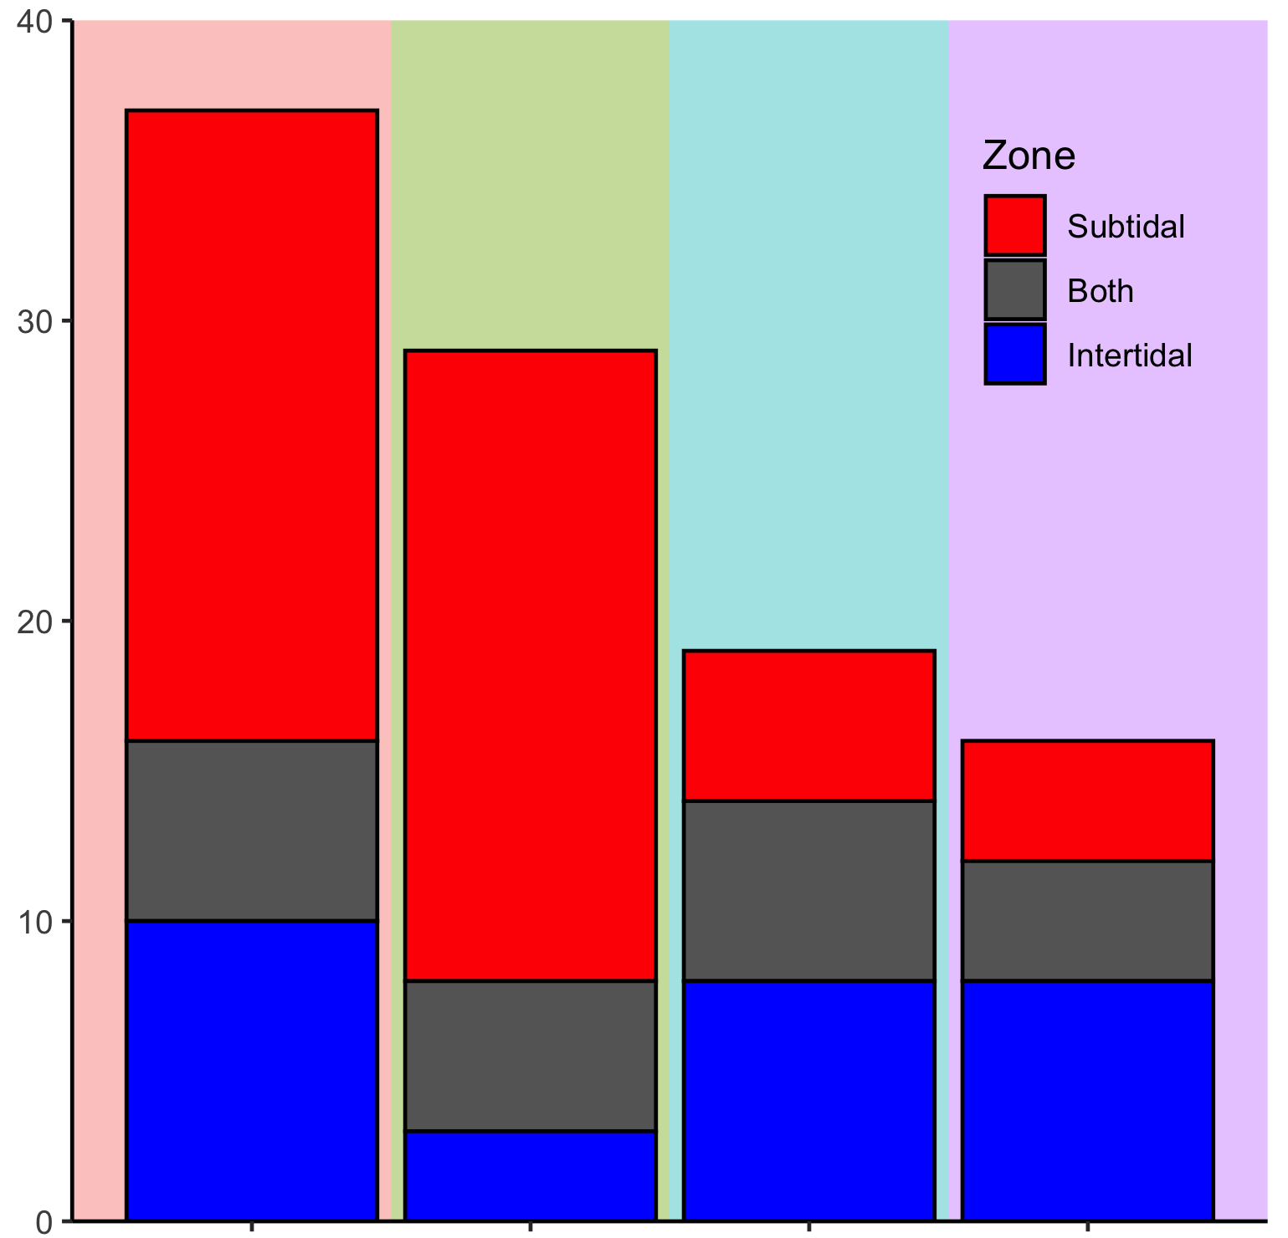
Network divisions are not structured by habitat
optimal network partitioning
modularity = 0.30 (moderate)
Count
Group

Slide 22
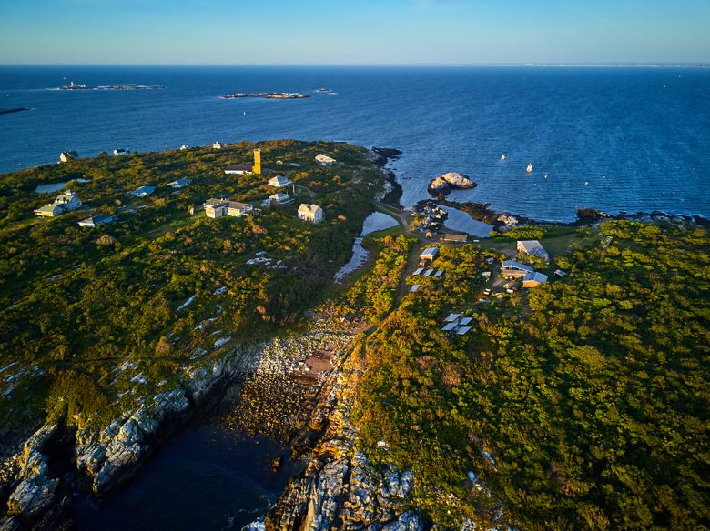
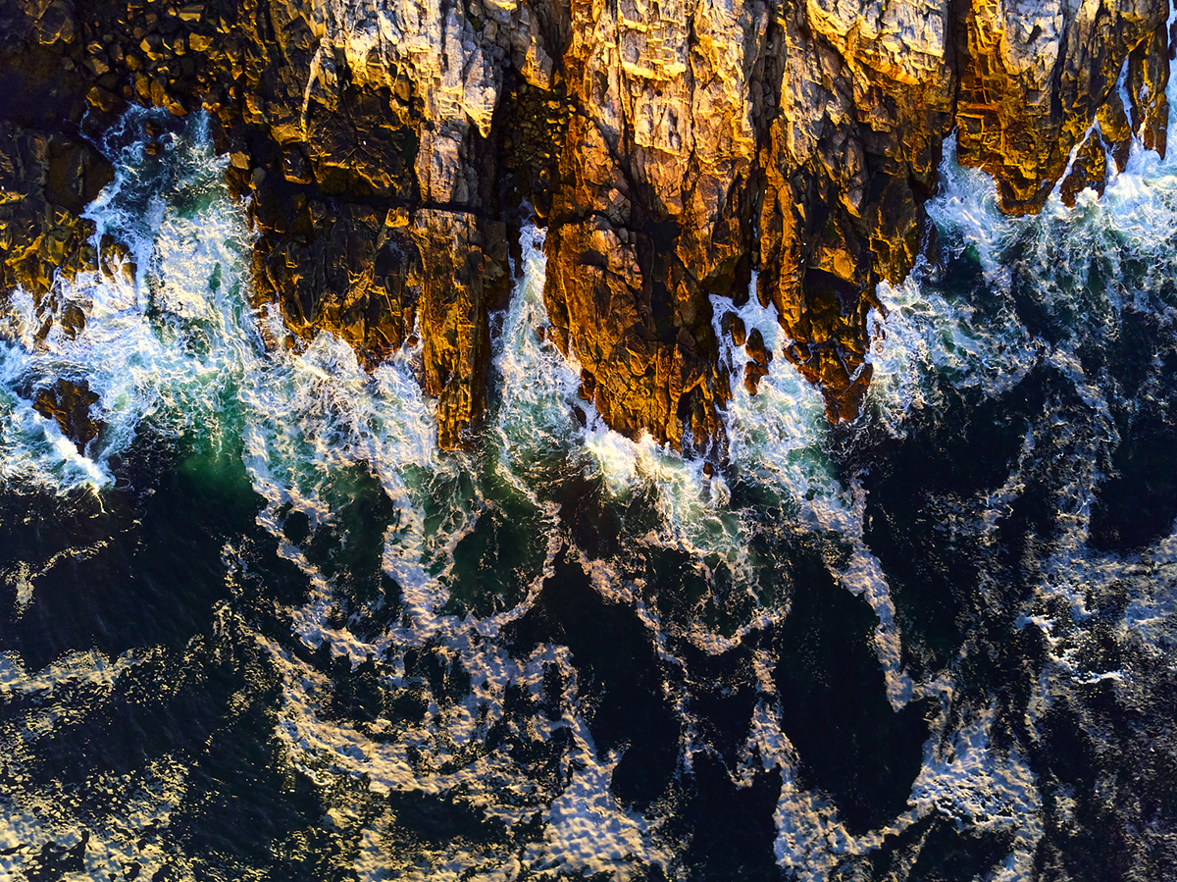
Future directions
Continue literature search for intertidal interactions database
Identify trophic interactions that couple the subtidal and intertidal
Image: Mark Fleming (Yankee Magazine)
apparent competition
exploitative competition
tri-trophic chain
omnivory
Simulations to evaluate how individual species extirpation affects network integrity
Incorporate relative abundance and species co-occurrence into a weighted network
Image: Mark Fleming (Yankee Magazine)

Slide 23
Take home messages
The nearshore community is a highly integrated network
It’s integrated in important ways that are missed when considering habitats as distinct networks
Modularity is not necessarily linked to habitat
Both + 1º links
Subtidal links to Intertidal

Slide 24

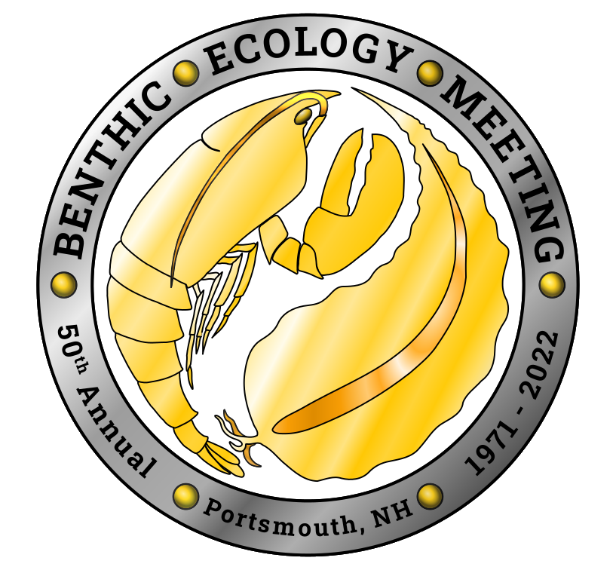










Thank you!
Thadinadonnih: “The place where they built”
I live and work on the ancestral territories of the Attawandaron, Anishinaabek, and Haudenosaunee, and treaty lands of the Mississaugas of the Credit.
@jbburant
joseph.burant@mcgill.ca

Slide 26
apparent competition
exploitative competition
tri-trophic chain
omnivory

Slide 27
